Slide 1
Introduction to XGBoost
Witold Merkel
Adam Rydelek
Michał Stawikowski

Slide 2
OUTLINE OF PRESENTATION
eXtreeeme!1!
Gradient
BOOSTing
Gentle Introduction.
How it works?
Why Use XGBoost?
XGBoost Features.
XGBoost in R and Python.

Slide 3

Gentle Introduction

Slide 4
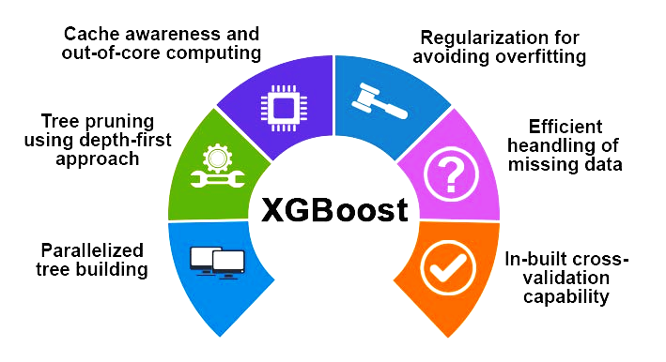
XGBoost is an implementation of gradient boosted decision trees designed for speed and performance.
,,The name xgboost, though, actually refers to the engineering goal to push the limit of computations resources for boosted tree algorithms. Which is the reason why many people use xgboost.’’
~ Tianqi Chen - researcher that started XGBoost project

Slide 5
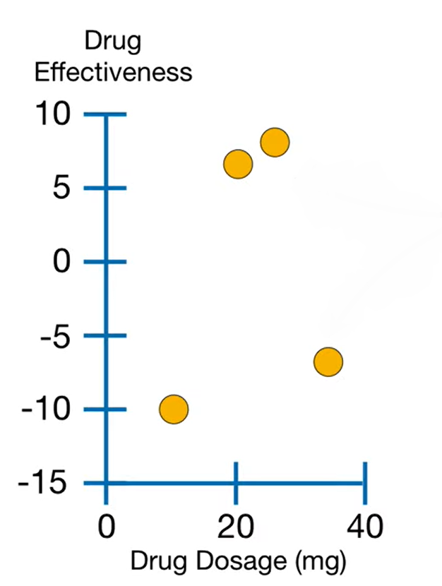
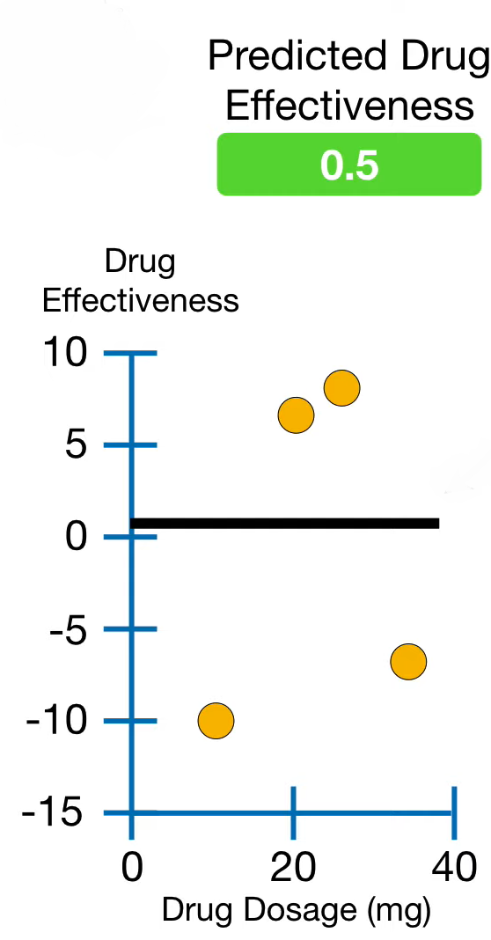
How it works in steps.
Our dataset.
2. First arbitrary prediction.

Slide 6
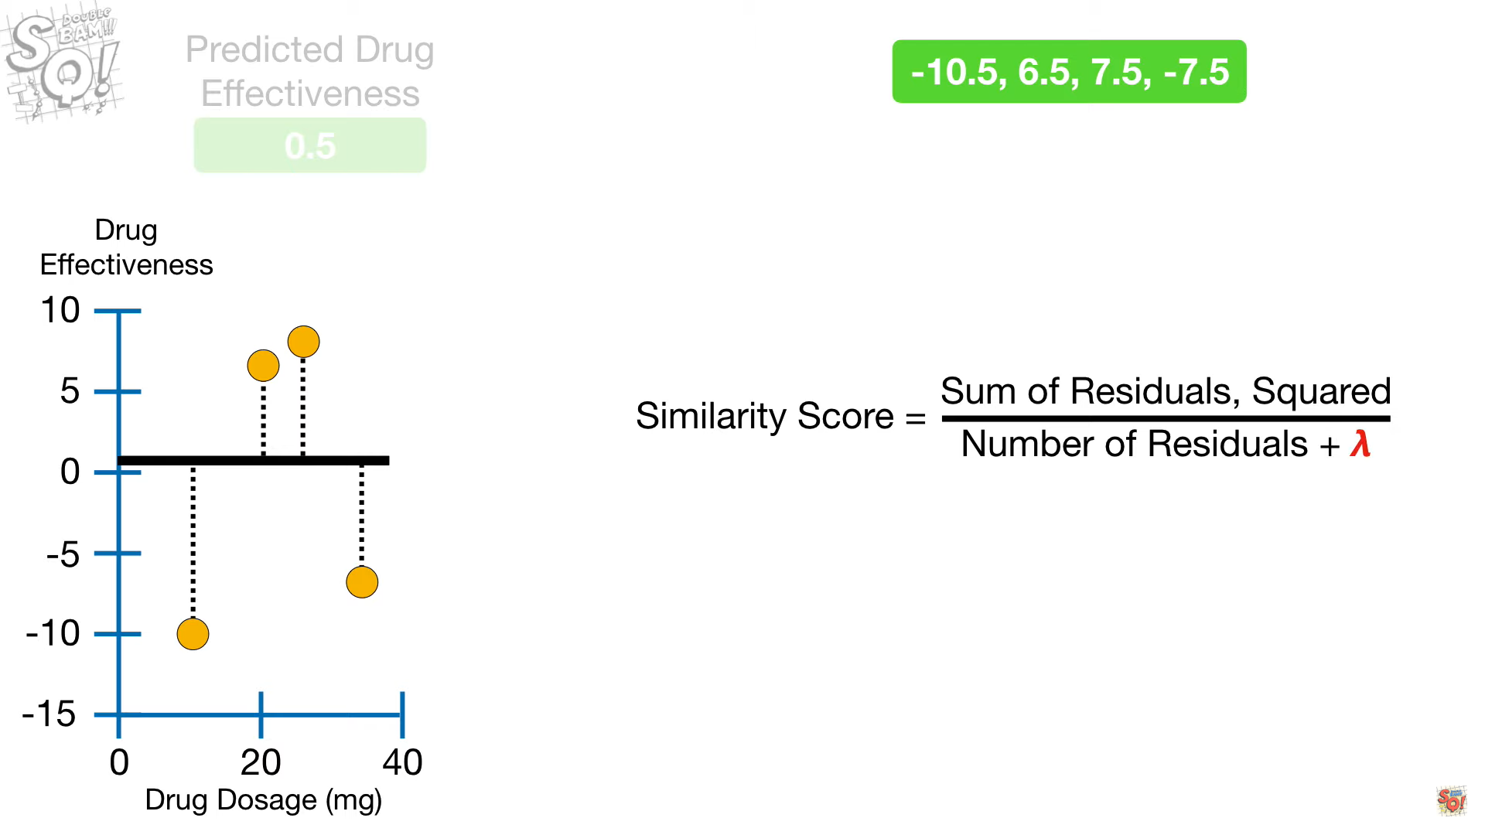
XGBoost trees and Similarity Score.

Slide 7
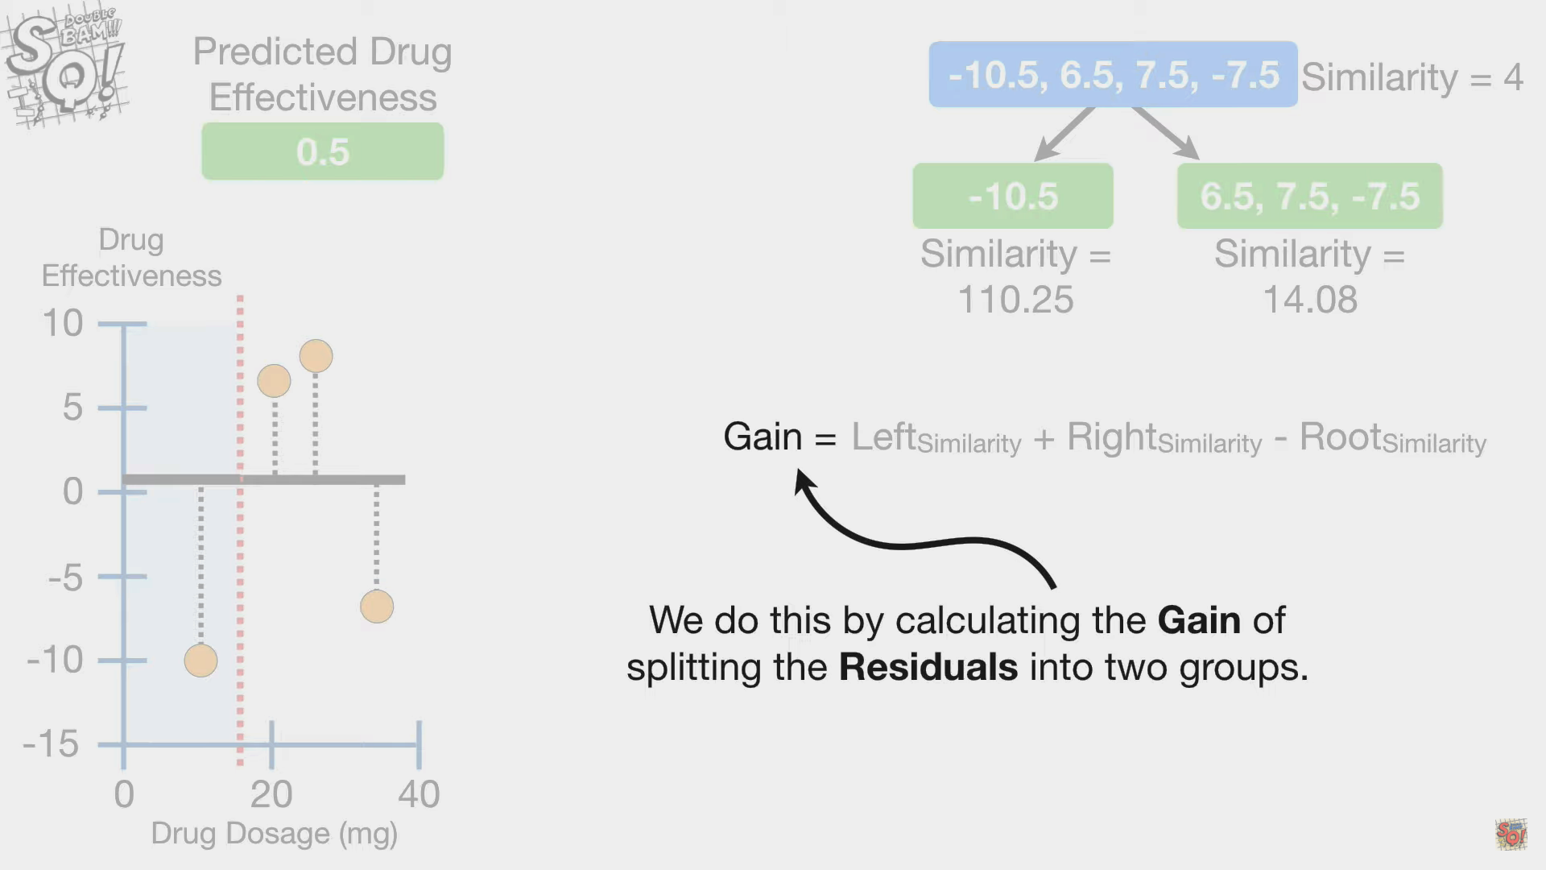
Choosing Thresholds and computing Gain.

Slide 8
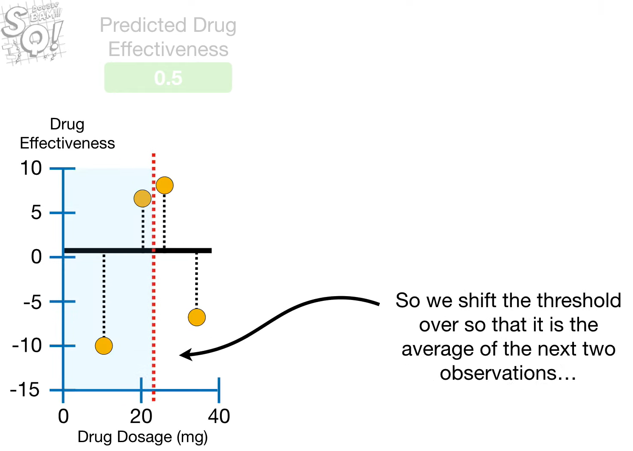
Shifting threshold and choosing the best one based on Gain.

Slide 9
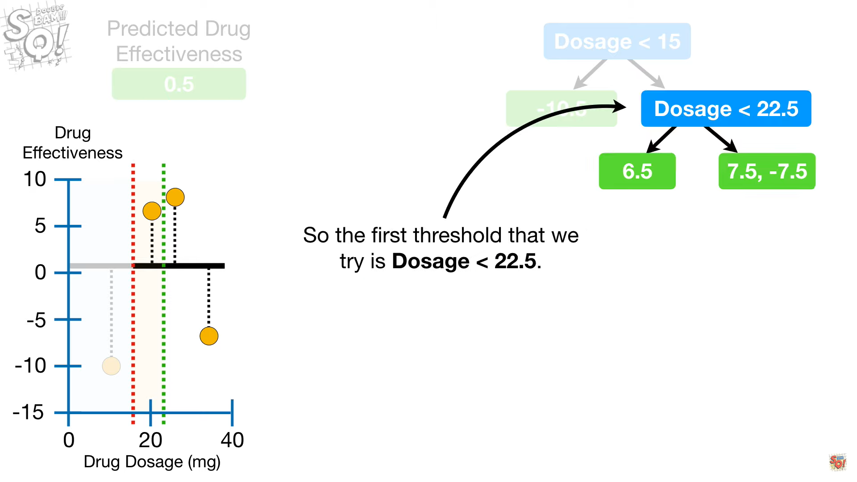
Deepening the tree and selecting next thresholds.

Slide 10
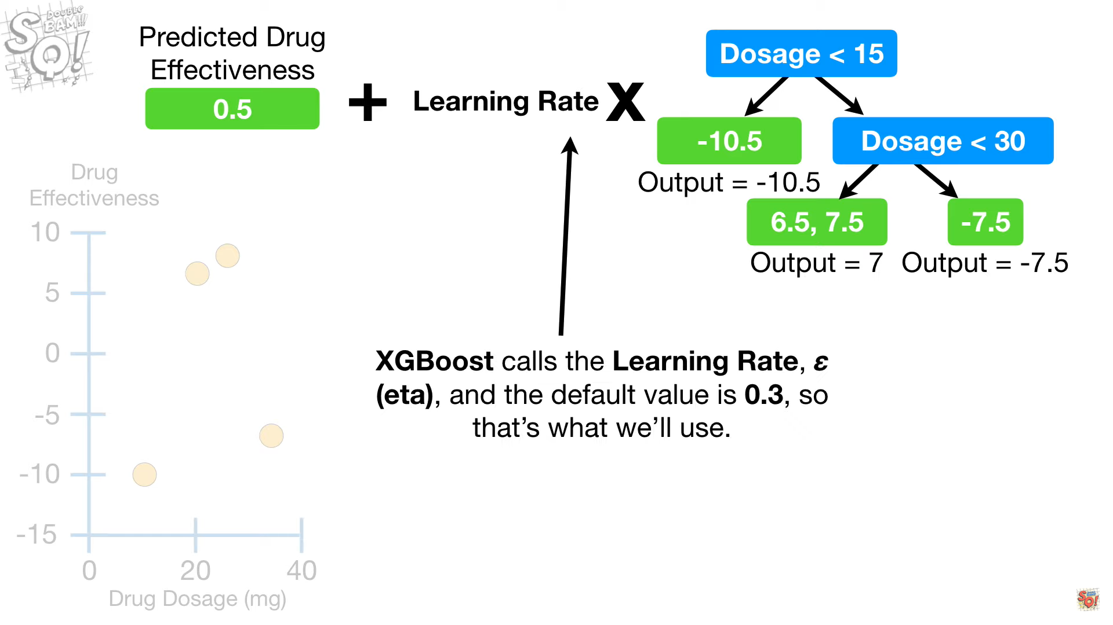
First iteration, updating predictions and residuals.

Slide 11
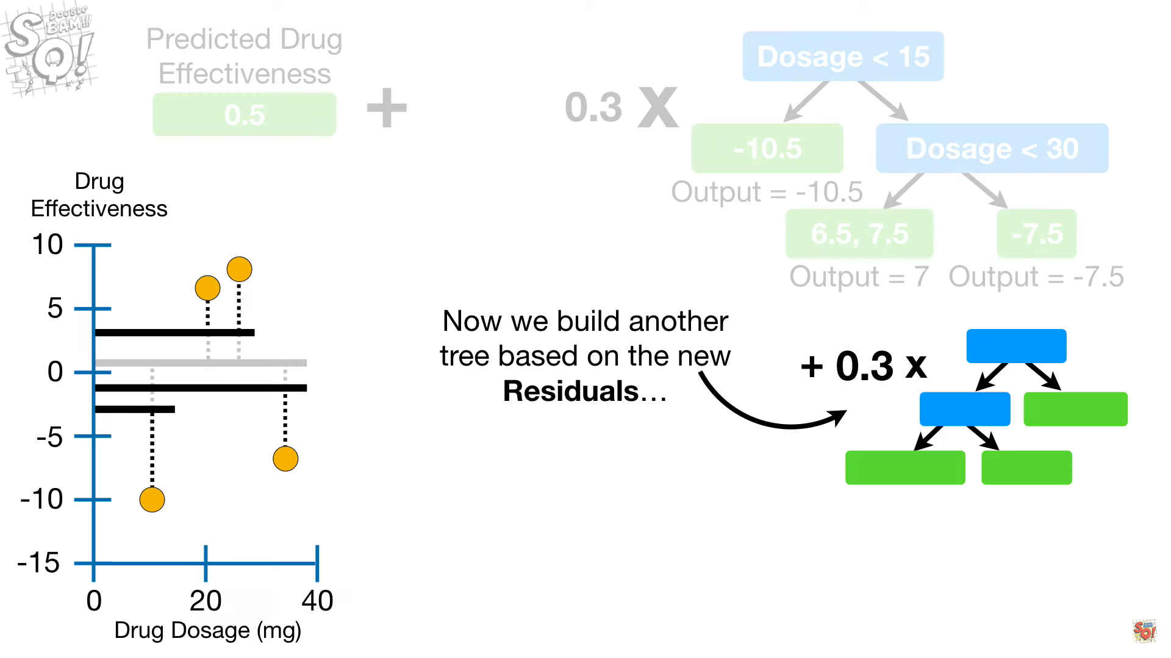
Next iterations based on better predictions...

Slide 12
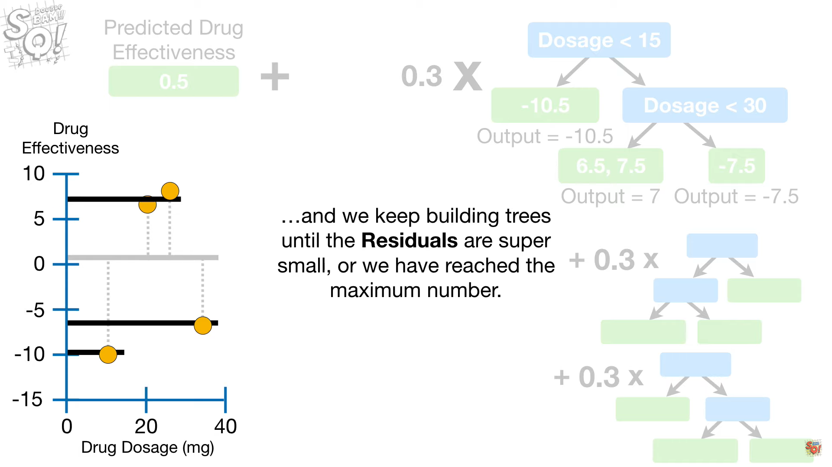
...till we get where we want.

Slide 13
Why should we use XGBoosting?
Execution Speed,
Model Performance.

Slide 14
SPEED!!!
XGBoost vs. Implementations of gradient boosting

Slide 15
PERFORMANCE
go-to algorithm for competition winners on the Kaggle

Slide 16
XGBoost Features
Model Features
System Features
Algorithm Features

Slide 17
Model Features
Gradient Boosting,
Stochastic Gradient Boosting,
Regularized Gradient Boosting.

Slide 18
System Features
Parallelization,
Distributed Computing,
Out-of-Core Computing,
Cache Optimization

Slide 19
Algorithm Features
Sparse Aware,
Block Structure,
Continued Training

Slide 20
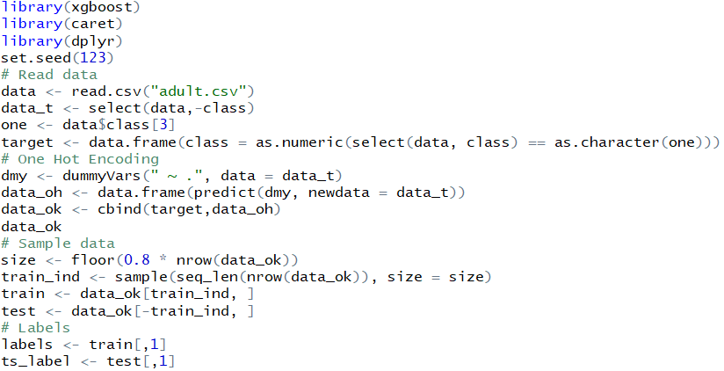
Implementation in R using xgboost package: data preparation

Slide 21
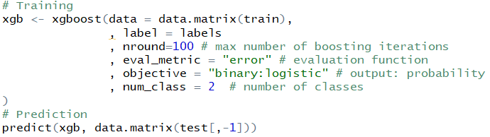
Implementation in R using xgboost package: training and prediction

Slide 22
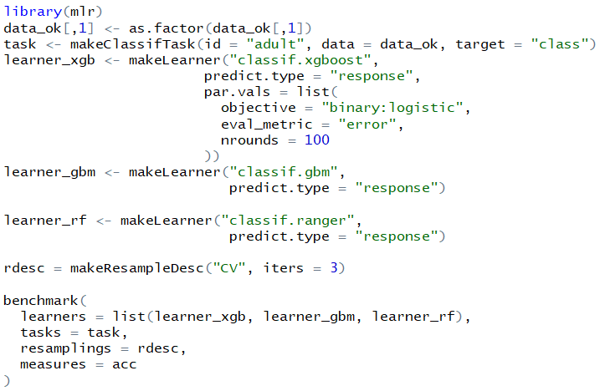
Comparison using mlr: XGBoost vs Ranger vs GBM

Slide 23
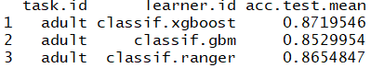
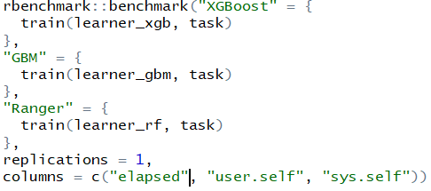
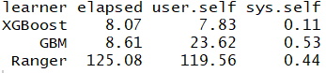
Comparison using mlr: results

Slide 24
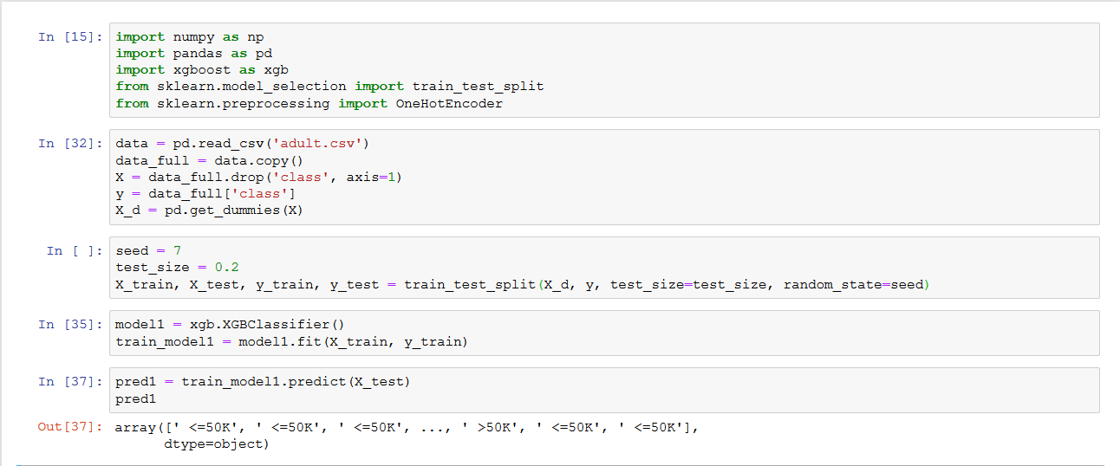
Implementation in Python

